Slide 1
BREAST CANCER PREDICTION USING ML TECHNIQUE
GAYATHIRI R

Slide 2
OBJECTIVE:
This analysis aims to observe which features are most helpful in predicting the patient require therapy or not and to see general trends that may aid us in model selection and hyper parameter selection. The goal is to determine the patient require therapy for breast cancer or not. To achieve this, I have used machine learning classification methods to fit a function that can predict the discrete class of new input.
DATASET COLLECTION:
This dataset is collected from University Medical Centre, Institute of Oncology, Ljubljana, Yugoslavia.
Thanks go to M. Zwitter and M. Soklic for providing the data.

Slide 3
BREAST CANCER
Breast Cancer is a disease in which cells in the breast grow out of control. There are different kinds of breast cancer. The kind of breast cancer depends on which cells in the breast turn into cancer.
Breast cancer can begin in different parts of the breast
SYMPTOMS:
New lump in the breast or underarm (armpit).
Thickening or swelling of part of the breast.
Irritation or dimpling of breast skin.
Redness or flaky skin in the nipple area or the breast.
Pulling in of the nipple or pain in the nipple area.
Nipple discharge other than breast milk, including blood.

Slide 4
ABSTRACT:
In this Work, Logistic regression is used for predicting the patient require therapy or not. Results are to be obtained in terms of the accuracy.
Logistic regression is commonly used for a binary classification problem. Here, we build a logistic regression model using a hospital’s breast cancer dataset, where the model helps to predict whether a patient requires therapy or not.

Slide 5
DATASET ATTRIBUTE INFORMATION:
Class(Indicator for first occurrence or reocurrence ): no-recurrence-events, recurrence-events.
age(Age of the Patient): 10-19, 20-29, 30-39, 40-49, 50-59, 60-69, 70-79, 80-89, 90-99.
menopause(Menopause Stage of the patient, lt40:late40, ge40:gestational40, premeno:Pre-menopause) :lt40, ge40, premeno.
Tumor-size: 0-4, 5-9, 10-14, 15-19, 20-24, 25-29, 30-34, 35-39, 40-44, 45-49, 50-54, 55-59.
Inv-nodes(Lymph nodes): 0-2, 3-5, 6-8, 9-11, 12-14, 15-17, 18-20, 21-23, 24-26, 27-29, 30-32, 33-35, 36-39.
Node-caps(capping of inv-nodes): yes, no.
Deg-malig(degree of malignancy): 1, 2, 3.
Breast: left, right.
Breast-quad: left-up, left-low, right-up,right-low, central.
Irradiat(Target Variable, Radiation Therapy Yes/No)

Slide 6
APPROACH:
Initially Dataset is loaded and undergone EDA techniques , then the model is build using the features available.
In this Work, Logistic regression is used for predicting the patient require therapy or not. Results are to be obtained in terms of the accuracy.
Logistic regression is commonly used for a binary classification problem. Here, we build a logistic regression model using a hospital’s breast cancer dataset, where the model helps to predict whether a patient requires therapy or not.
Why Logistic Regression?
Logistic regression is used to obtain odds ratio in the presence of more than one explanatory variable. Using a quantitative modeling technique such as logistic regression, to predict the risk of breast cancer, may help radiologists manage the large amount of information available, make better decisions, detect more cancers at early stages, and reduce unnecessary biopsies and can determine whether the patient require therapy or not.

Slide 7
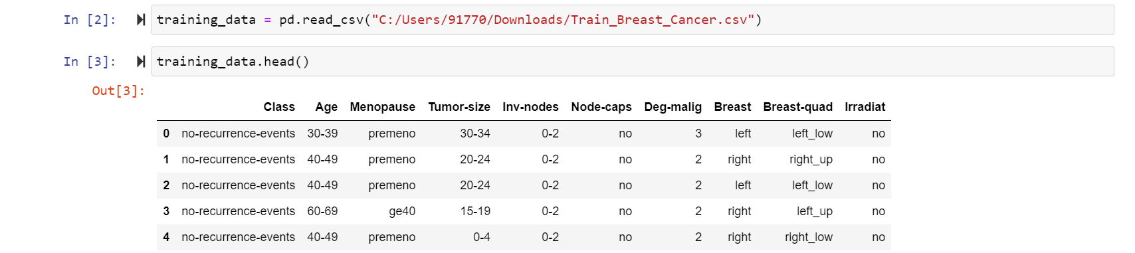
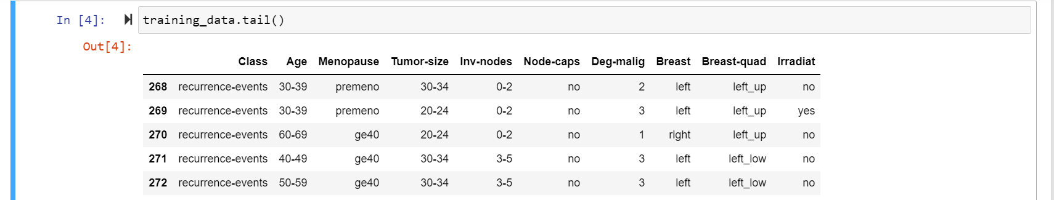
LOADING OF A DATASET: The dataset is loaded and it is examined by using head() and tail()

Slide 8
EXPLORATORY DATA ANALYSIS:
EDA is the process of investigating the dataset to discover patterns, and anomalies (outliers), and form hypotheses based on our understanding of the dataset. EDA involves generating summary statistics for numerical data in the dataset and creating various graphical representations to understand the data better.
In this work, I have done Countplot, Boxplot, Pairplot, Histplot with the available data.

Slide 9
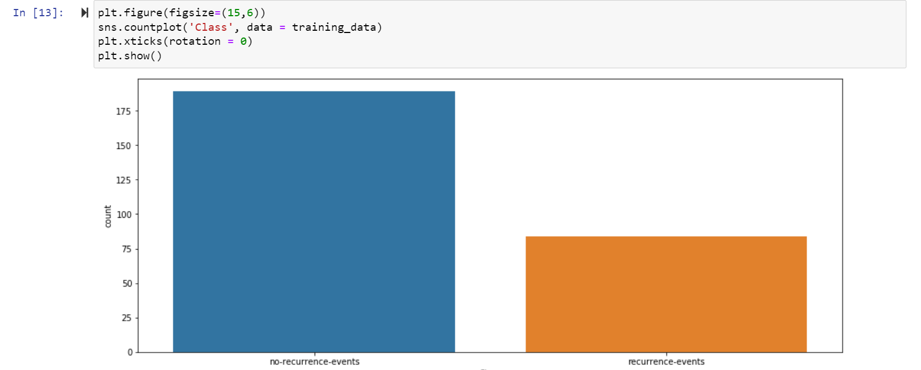
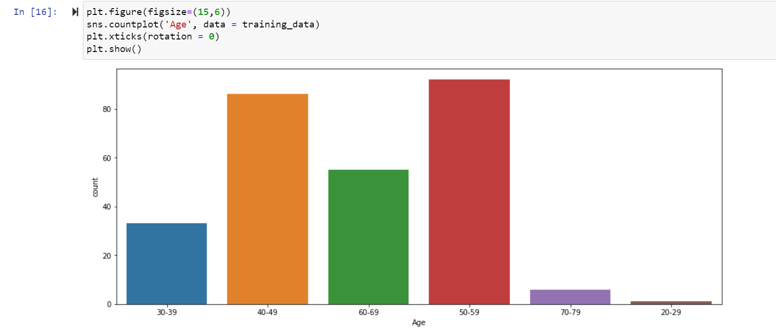
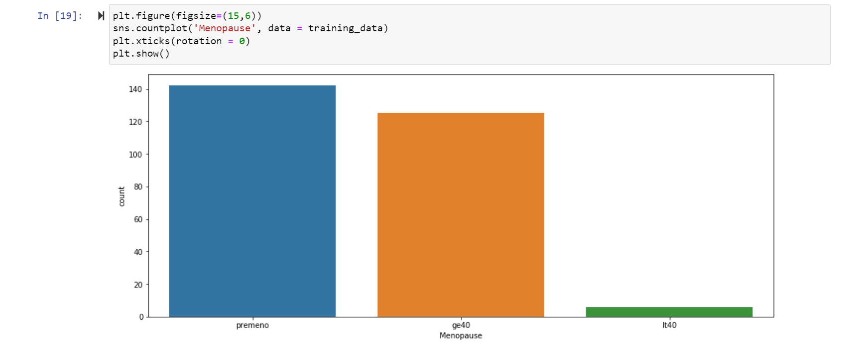
COUNTPLOT:

Slide 10
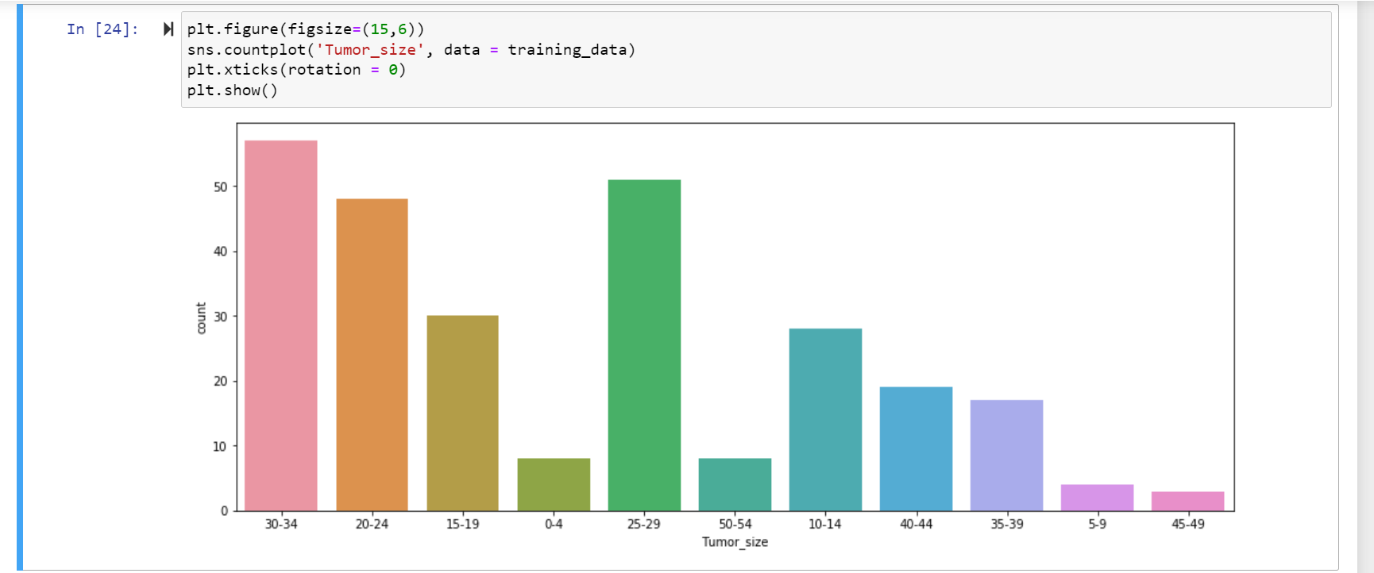
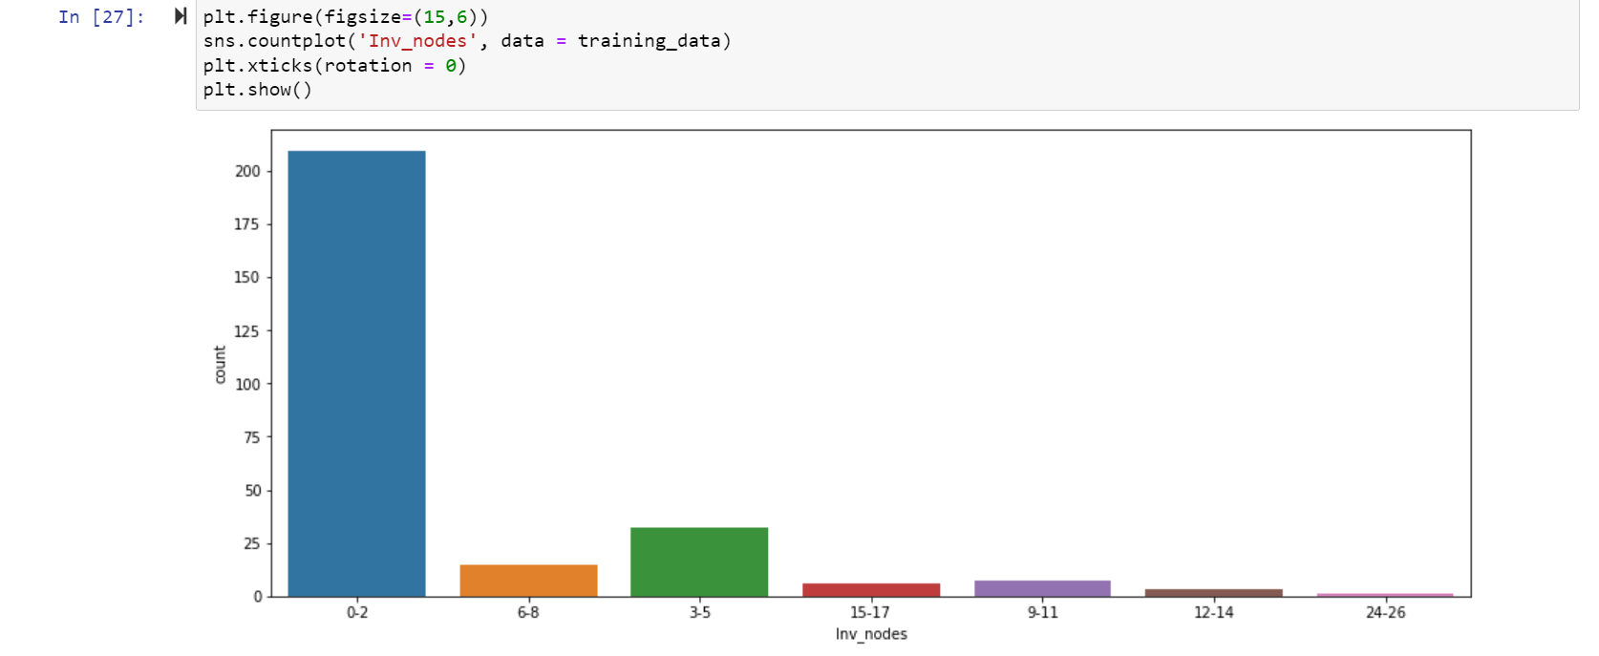
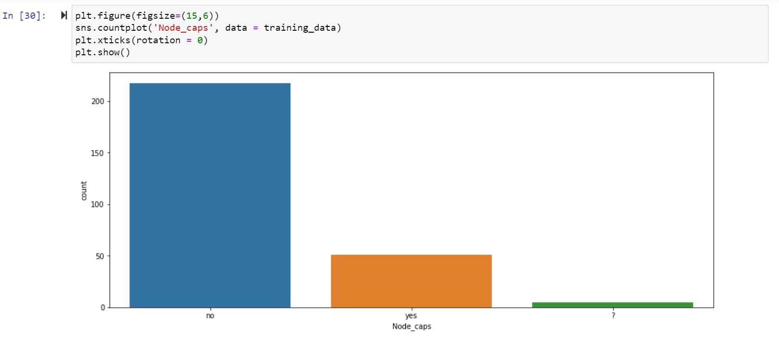
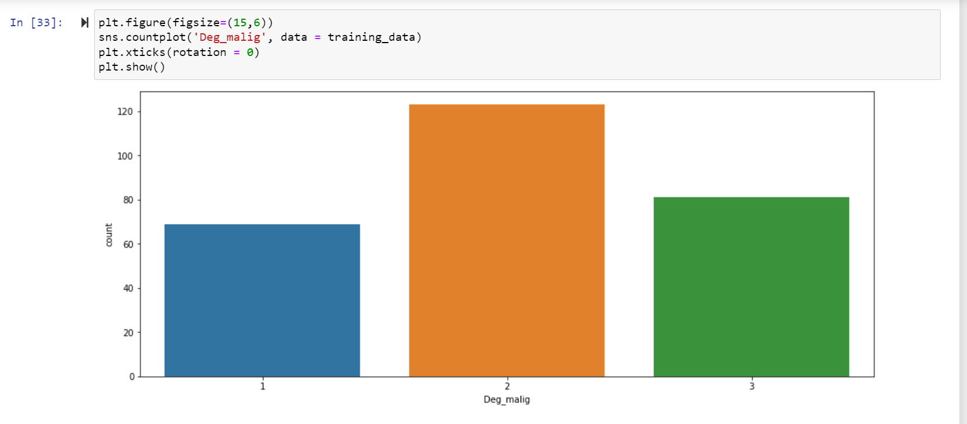

Slide 11
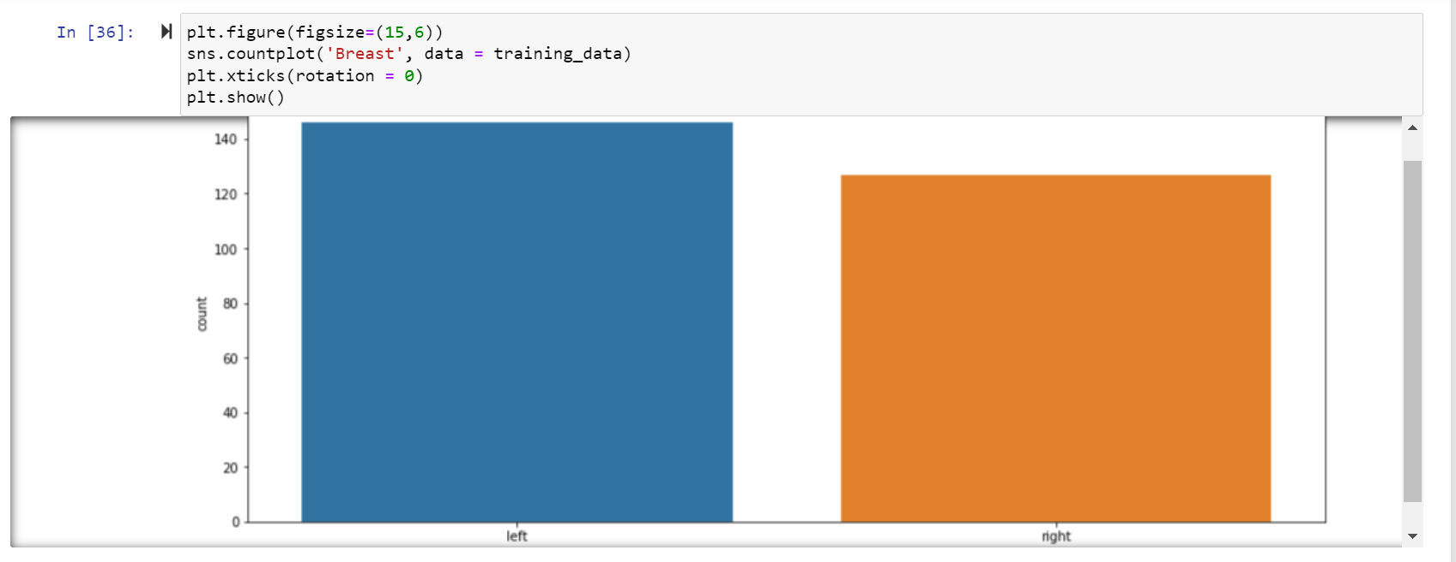
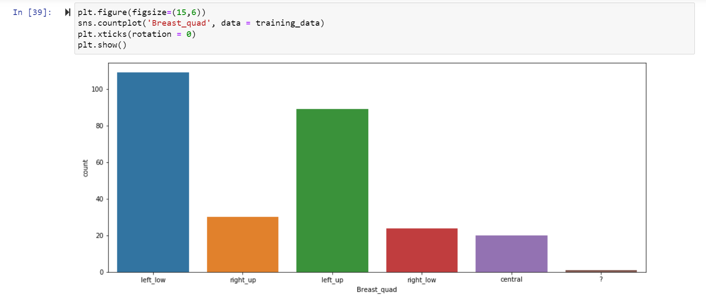
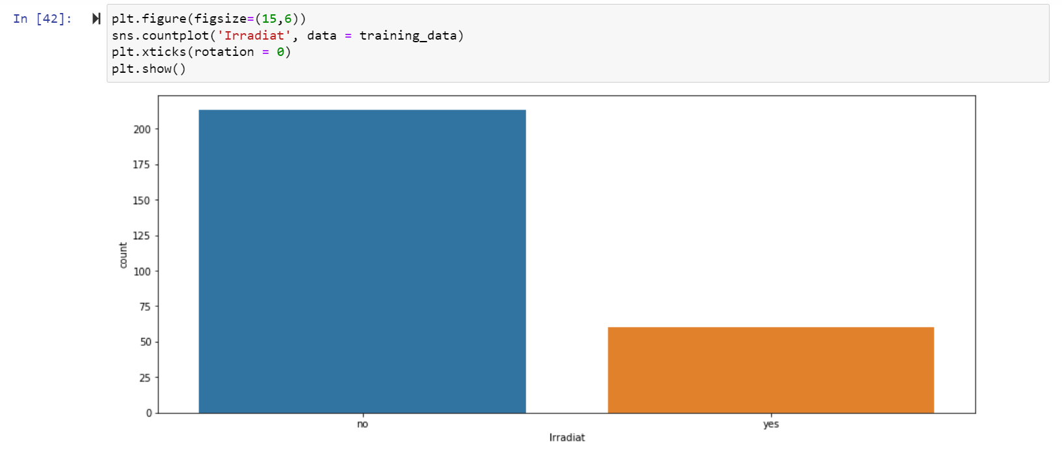

Slide 12
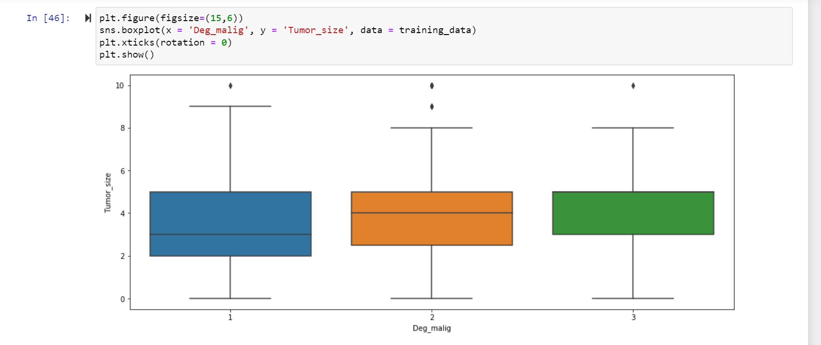
BOXPLOT:

Slide 13
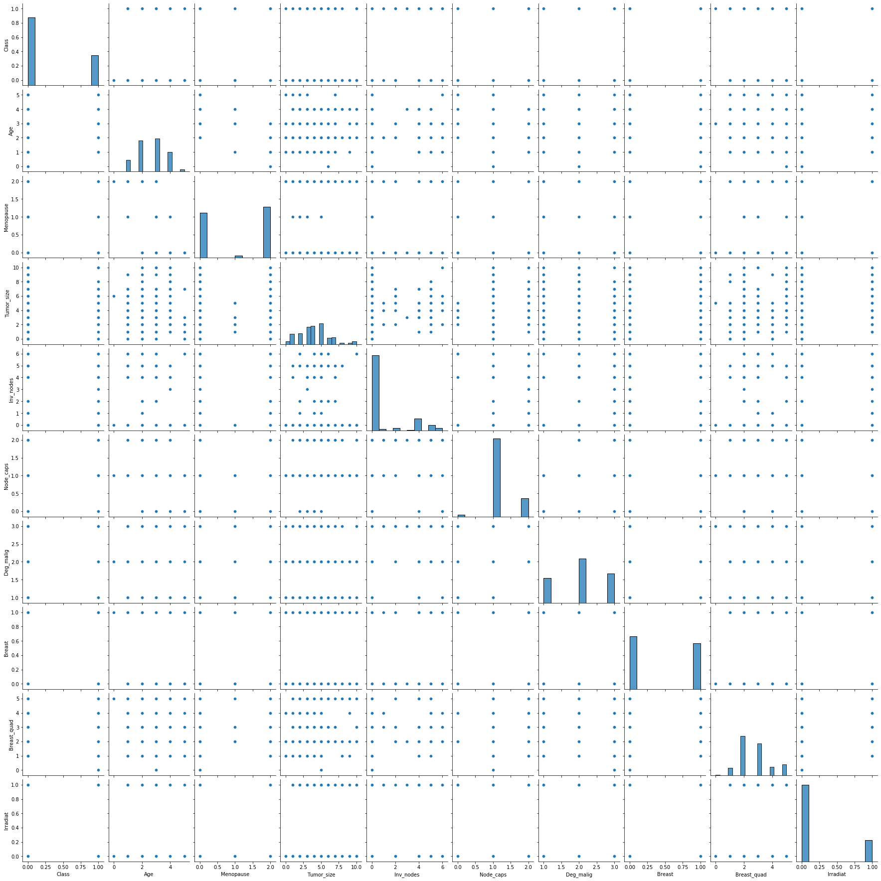
PAIRPLOT:

Slide 14
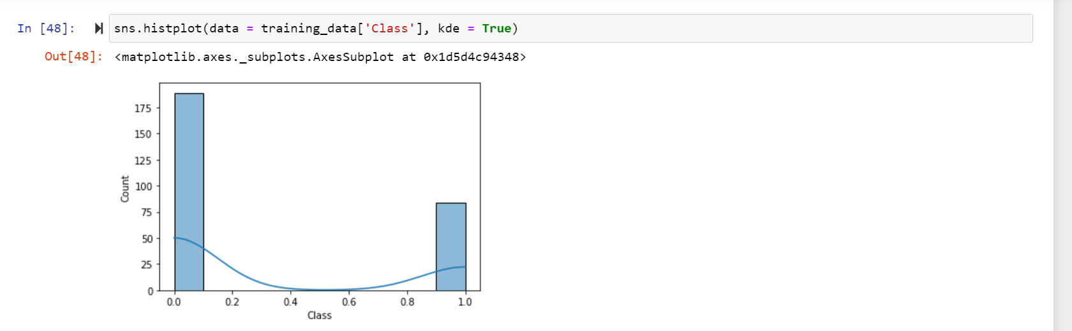
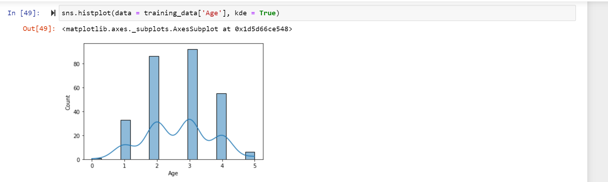
HISTPLOT:

Slide 15
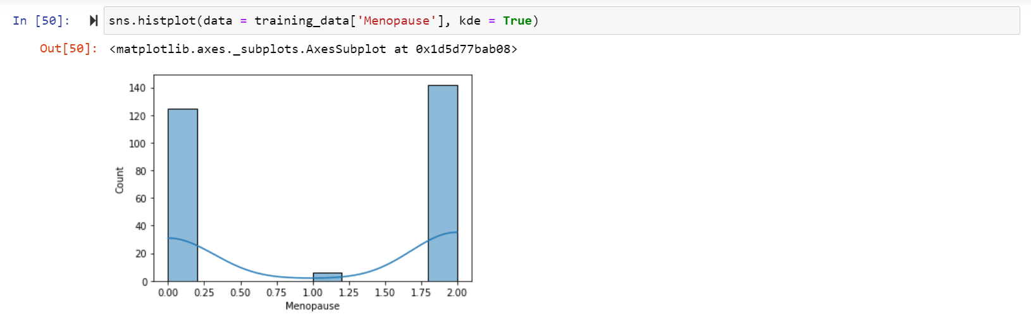
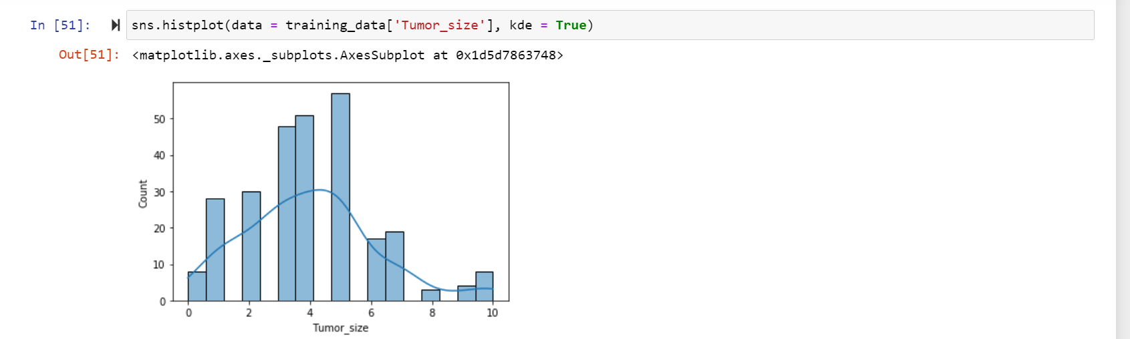
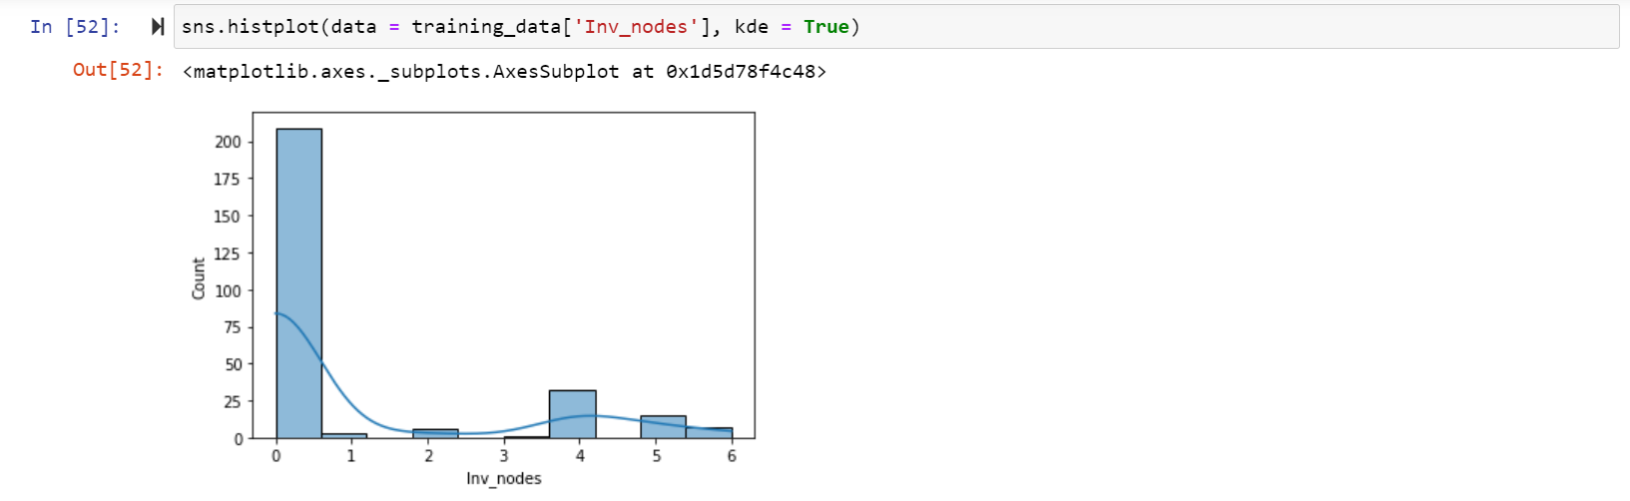
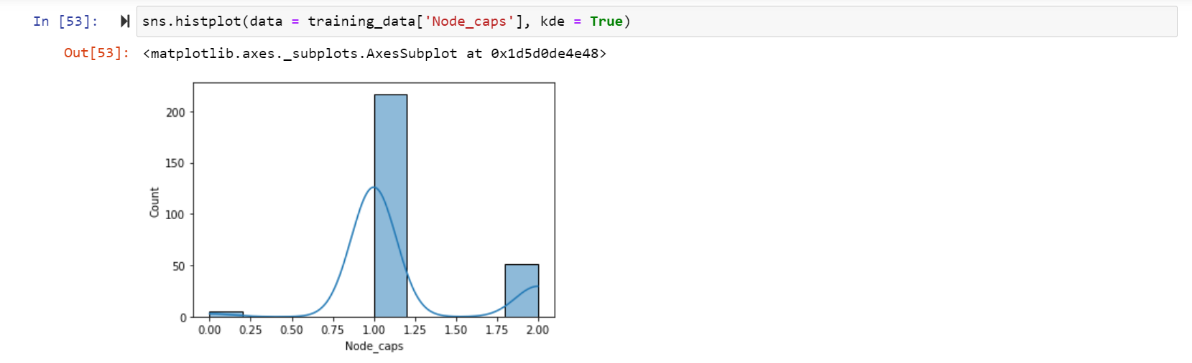

Slide 16
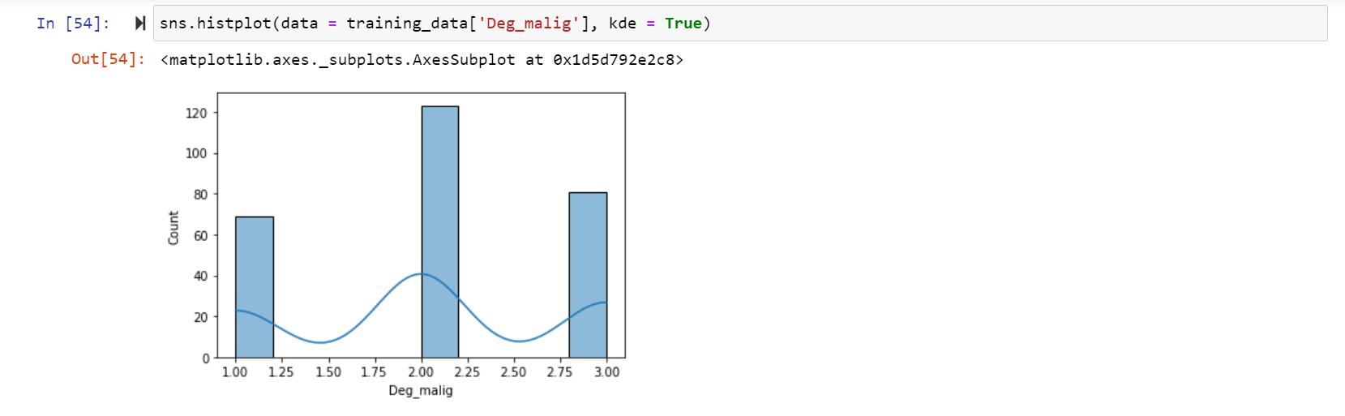
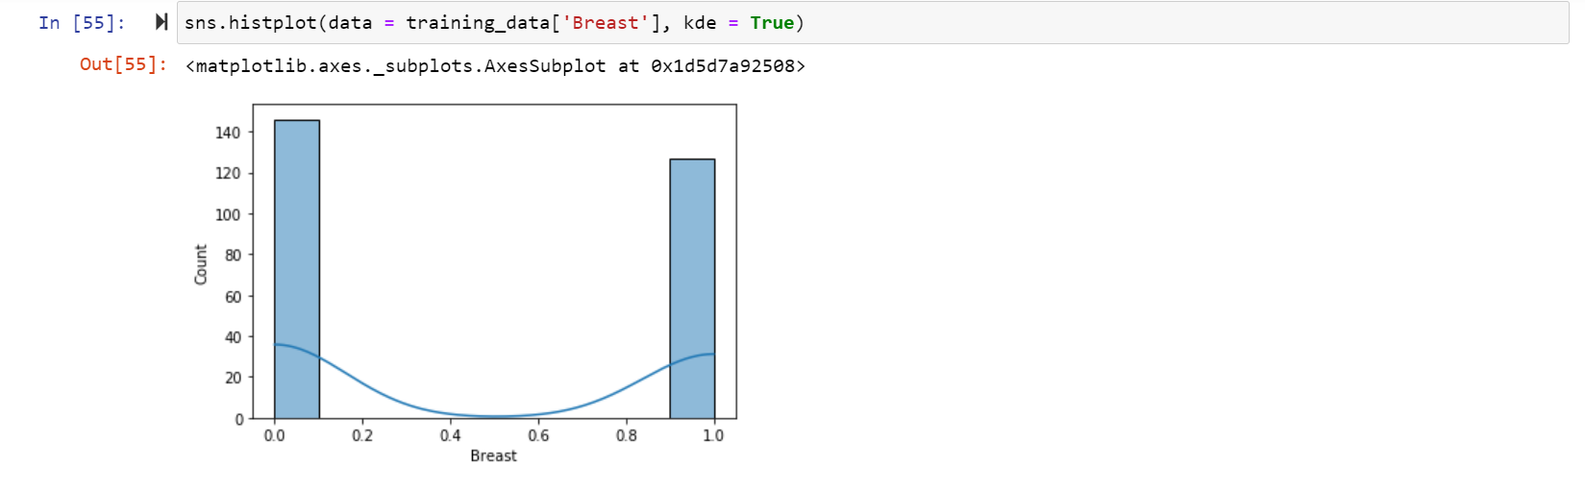
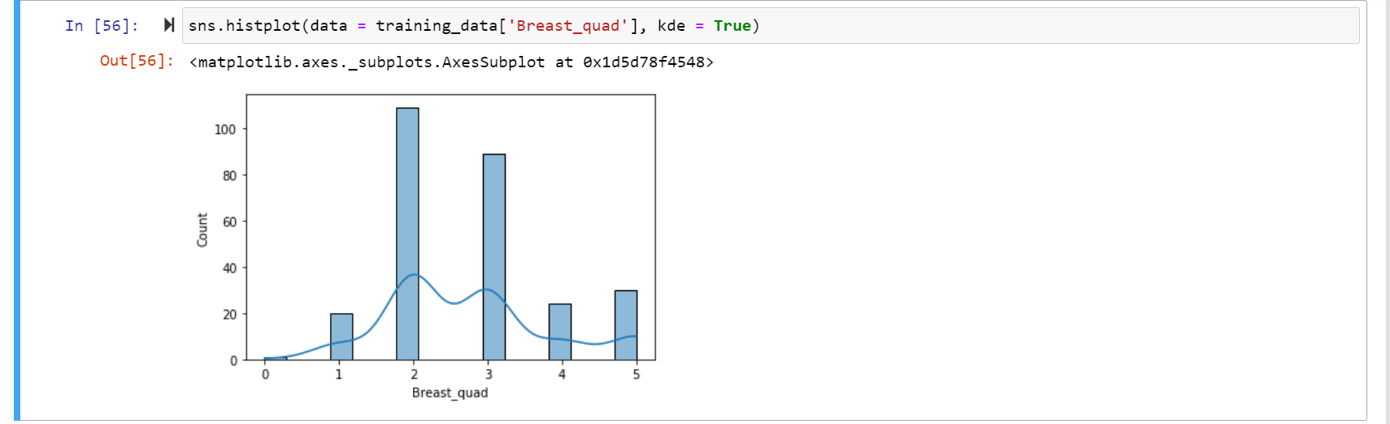
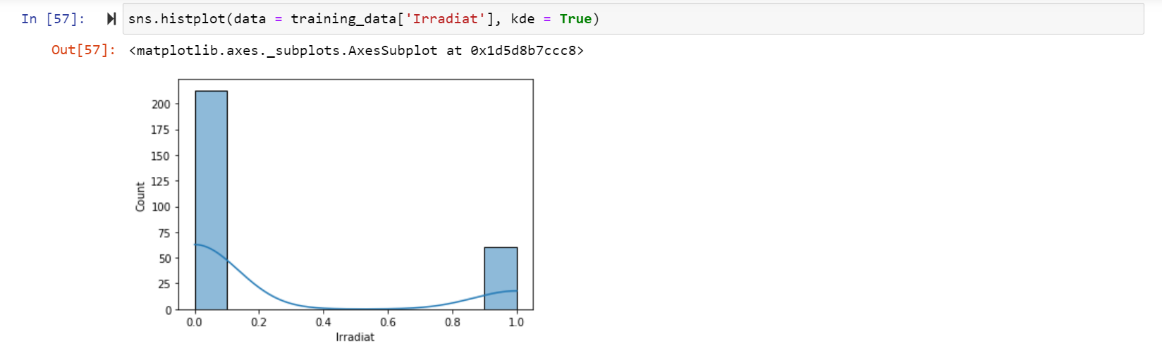

Slide 17
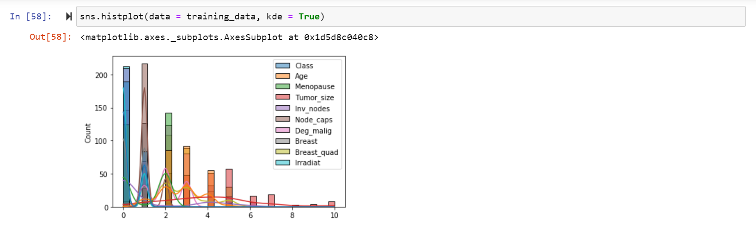

Slide 18
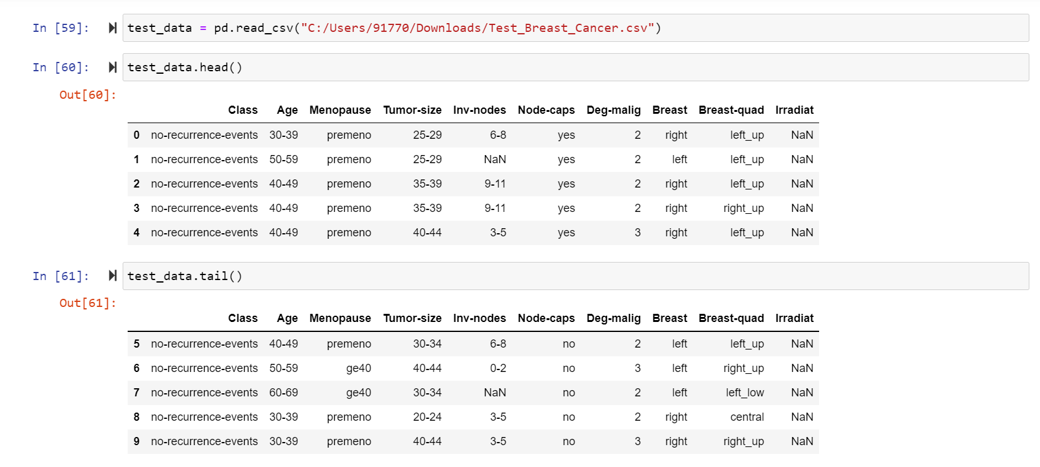
LOADING OF TEST DATA: The data is loaded and examined by head() and tail()

Slide 19
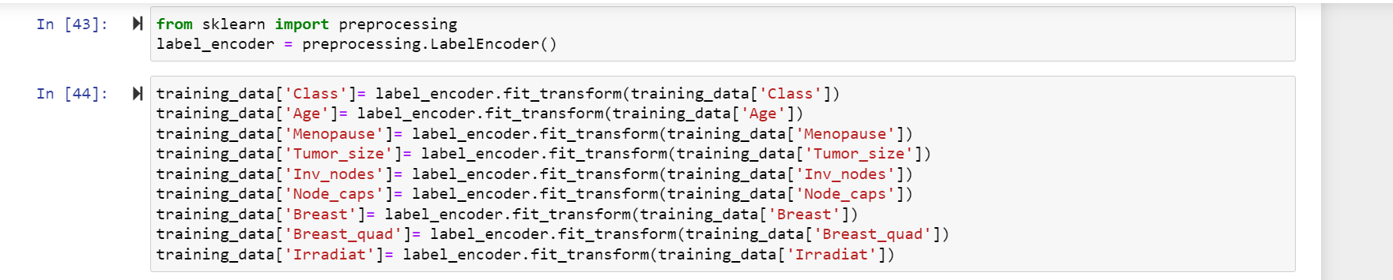
LABEL ENCODER: Label Encoding is a popular encoding technique for handling categorical variables. In this technique, each label is assigned a unique integer based on alphabetical ordering. Label Encoder can be used to normalize labels. It can also be used to transform non-numerical labels to numerical labels.

Slide 20
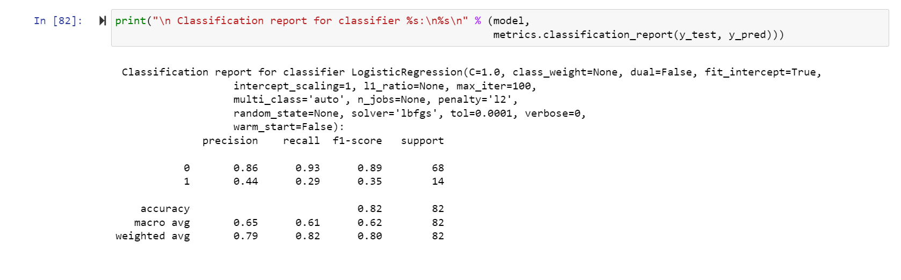
MODEL ACCURACY:

Slide 21
RESULTS:
The proposed model is the precision of breast cancer patients needs therapy or not. The dataset is collected and used for training and testing. Results shows that the build model shows accuracy of 82%. The prediction result whether the patient needs therapy or not is stored as CSV file.
0 indicates No therapy needed.
1 indicates Therapy needed.

